Slide 1
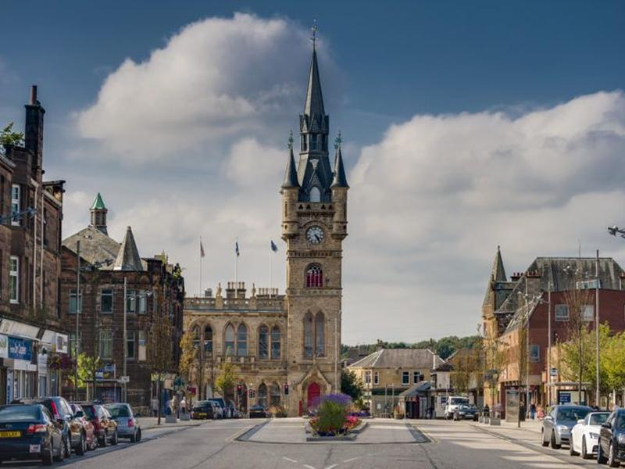
Renfrewshire Resident Survey
Equalities
Focus Groups
Key Findings Report

Slide 2
Background
Research Resource carried out Renfrewshire Council’s 2025 Resident Satisfaction Survey.
A representative cross section of 1,016 Renfrewshire residents were interviewed either face to face or by phone during May and June 2025.
The objective of the Residents Survey was to measure residents’ current perceptions and satisfaction with the Council, access new information, ideas and suggestions which will improve planning and decision making in relation to budget decisions and help shape future activities around resident needs and priorities.
6 focus groups were then carried out with respondents to explore their perception and satisfaction in more depth and provide further insight into resident priorities.
A further 5 focus groups were then carried out with specific equalities groups.
This report summarises the key findings of the additional 5 equalities focus groups.

Slide 3
Focus group profile
5 focus groups were carried out between 17th March and 2nd April 2026.
Focus group participants were recruited from resident representative groups in Renfrewshire. These were the Disability Resource Centre (x2 focus groups), the Lived Experience Panel and Renfrewshire Youth Voice (x2 focus groups)
Focus groups were carried out in person, daytime and evening.
Overall 39 residents participated in the focus groups.
Residents were from across Renfrewshire, including the more rural villages and ranged in age from 16 to into their late 60s.
Participants were from a range of equalities groups and voices from across Renfrewshire were heard from young people, young carers, minority ethnic groups, those from more deprived communities, LGBTQI and disabled.

Slide 4
Focus group themes
The focus groups sought to provide insight from disabled residents, the Lived Experience Panel and young people regarding what it is like living in Renfrewshire and what their priorities were for the Council.
The discussion themes were:
Council priorities
Understanding residents priorities for Council priority themes
Place and Neighbourhood
What is it like living in Renfrewshire?
What impacts residents quality of life?

Slide 5
Place and Neighbourhood

Slide 6
Place and neighbourhood
Positives about living in Renfrewshire
Overview: Across all three groups, people spoke with honesty about life in Renfrewshire. There is clear pride in place and attachment to local areas.
Strong attachment to place: Across groups participants described Renfrewshire as home, even if they were unhappy with current conditions. Many had long histories of living in the area, family and community ties, pride in local identity and were reluctant to leave. They cared about Renfrewshire and want it to be better.
Sense of community: It was clear from participants that one of the key things that makes Renfrewshire such an enjoyable place to live is the people who live there. Participants spoke consistently about the friendliness of neighbours and local people, peer support (especially amongst disabled residents e.g. at the Disability Resource Centre), informal support networks (e.g. young people spoke about friends and informal social networks), and staff and volunteers in community spaces. .
Greenspace, culture and events: Many spoke positively about parks and green spaces (where they are safe and accessible). The festivals, arts and local events were widely praised as an opportunity to come together across communities. Young people in particular highlighted culture and events as a way to improve their mood, reduce boredom and a way of creating pride in the area and a sense of belonging.

Slide 7
Place and neighbourhood
Negatives about living in Renfrewshire
Safety and feeling safe: Across all groups people described not feeling safe in their daily lives. This varied by group with a slightly different focus on safety for each group. For disabled residents key things impacting on their feeling of safety were things such as unsafe pavements, lighting and infrastructure. Young people spoke about a fear of violence, harassment and assault. The Lived Experience Panel lived with fear in their daily lives, largely due to anti-social behaviour in their communities. For all groups fear restricts them, it stops them going out, they keep their children indoors, disabled residents avoid journeys and young people lose their independence.
Loss of community spaces and “places to go”: All groups spoke about the disappearance or inaccessibility of shared spaces. Examples were closed or under used community centres, few indoor spaces that are free or affordable, limited provision for youths or spaces not designed for disabled access. The loss of these spaces were linked to isolation, boredom and declining mental wellbeing. Participants want safe, physical spaces where they are welcome. The Lived Experience Panel in particular spoke about a need for a 24 hour safe place that was warm, safe, gave you access to wifi, access to information and snacks and drinks.
Inequality, invisibility and lack of voice: Groups were also vocal about their feeling of not being heard. They felt that decisions were made without lived experience, that engagement does not always lead to change or that consultation happens too late and is not taken seriously. There was also a feeling that some areas are prioritised over others with one noting that postcode assumptions of poverty are masking the full extent of poverty experienced across Renfrewshire.
Support systems not keeping up with need: All groups spoke of systems under strain and all groups spoke about a strong need for more mental health support. Young people spoke more about support in schools and CAMHS whereas adults spoke more about community, housing and income pressures.

Slide 8
Place and neighbourhood
What could improve your quality of life?
Across all groups, there was a striking consensus on what would actually make a difference
Feeling safe to move around, get together and live: This was seen as the foundation for all groups with priorities including better lighting, well maintained and safe routes and pavements to move around on, visible community safety presence and safe and accessible public buildings and schools.
Accessible, welcoming community hubs: Welcoming community hubs were desired by all groups but importantly they had to be free or low cost, open beyond office hours so that people can come together in safety in the evenings and at weekends, suitable for all ages, designed to be accessible and inclusive for all. Disabled residents and the Lived Experience Panel, in particular, wanted to see community spaces rebuilt and protected.
Spaces and activities that are not income dependent: Participants spoke about a desire to have affordable things to do that are close to home. This included both indoor and outdoor options – parks, leisure centres, community centres cultural activities and cafes. Young people wanted access to spaces in the evening that are not alcohol focused. Importantly, across all groups, there was a desire to have activities for different ages and abilities that were accessible. For young people this would have a positive impact on their safety, boredom and lack of independence.
Being listened to and seeing change happen: Participants note that quality of life was linked to feeling that they are taken seriously, being involved in decisions, seeing longer term commitment to them and their communities, not just short term projects, and knowing that their input, time and feedback leads to action. The Lived Experience Panel specifically felt that people’s lived experiences should shape decisions from the start. Disabled people would like to be involved in housing, building and street design from the start.

Slide 9
Council Priorities

Slide 10
Council priorities
Prioritisation activity
It was explained to participants that the Council’s funding comes from a number of different sources and that each year the Council has to agree on how this budget will be spent and that the Council has to balance its budget every year. Each participant was given tokens which they had to use to identify their greatest priorities. They must allocate one token to each priority and then could allocate additional to any priority as they saw fit.
This identified priorities in the following order:
 | Disabled | Young people | Lived Experience Panel | Total
Support vulnerable people | 28 | 14 | 18 | 60
Maintain roads, pavements, open spaces and public places | 31 | 9 | 13 | 53
Support the health and wellbeing of children and families | 18 | 11 | 21 | 50
Support older people | 16 | 10 | 9 | 35
Support libraries, community and sports & leisure facilities | 15 | 9 | 11 | 35
Community safety services | 16 | 10 | 8 | 34
Support cultural activities, arts, museums and events | 15 | 10 | 9 | 34
Support people into training, employment and education | 8 | 12 | 8 | 28
Support local businesses | 14 | 7 | 0 | 21
Housing* | 14 |  |  | 14
Support tourism and the visitor economy | 9 | 2 | 1 | 12
Invest in measures to achieve Net Zero for Renfrewshire | 3 | 5 | 2 | 10
Invest in school buildings and our learning estate | 3 | 1 |  | 4

Slide 11
Cross cutting themes
It was noted that there are a lot of cross cutting themes across priorities and participants did not always find it easy discuss what was important about one particular priority without straying into other priority areas.
For example children and young people were a priority group but that crossed into health and wellbeing, education, maintenance of public spaces, libraries, community and sports & leisure facilities and also community safety.
A further example is that supporting vulnerable people strayed into older people, disabled people, income deprived and children and families. Community safety and accessibility was also a strong focus for supporting vulnerable people.

Slide 12
Priorities
Supporting vulnerable people
This was one of the highest priorities across all groups.
Across all three groups, there was a clear rejection of the idea that “vulnerable people” are a small or separate group. Instead, vulnerability was described as: widespread and increasing, often temporary or situational, closely linked to poverty, disability, caring responsibilities, mental health, and safety.
People spoke about systems for support being hard to navigate, slow to respond, and not preventative, meaning problems escalate before support arrives. It was believed that waiting times for support were too long and that people often fall between services meaning that they are relying on informal support.
There was also a strong desire for stable, predictable services that won’t disappear instead of short-term pilots or temporary funded projects.
Specific issues for groups were:
  Disabled people spoke about reduced care hours despite increasing needs.
  Young carers in the young persons group spoke about a lack of understanding from schools about their situation or that hidden disabilities are being overlooked. Access to CAHMS was a significant issue.
  The Lived Experience Panel spoke about financial pressures pushing more and more people into vulnerability and that there is concern over judgement and stigma when asking for help.

Slide 13
Priorities
Maintaining Roads, Pavements, Open Spaces and Public Places
This theme was about much more than maintenance.
People described infrastructure as a foundation for safety and independence. Poorly maintained or badly designed spaces were seen as dangerous, excluding and anxiety inducing, creating a barrier to every day life.
This theme was noted by disabled participants as their single most important issue. Their key concerns were uneven pavements and poor camber causing falls, narrow pavements forcing wheelchair users into road, missing or blocked drop kerbs and parks that look nice but aren’t usable. They also spoke about parks that look nice but aren’t usable for them.
The Lived Experience Panel focused less on disability access but strongly linked infrastructure to feeling safe with notes of a decline in neighbourhoods and a lack of pride in their local areas.
Young people mentioned infrastructure mainly in relation to lighting, parks, and routes, noting that that can inhibit them and make them feel unsafe and stop them going out.

Slide 14
Priorities
Support the health and wellbeing of children and families
Supporting children and families was the top priority for the Lived Experience Panel and a major theme for young people and disabled people.
It was framed as a priority not just for now but also for preventing issues in the future with early years support seen as key to prevent bigger issues in the future.
It was also discussed as having a lot of cross cutting issues where participants linked children’s wellbeing into community safety, availability of safe places to go, cost of living, mental health support and support for parents and carers.
For the Lived Experience Panel there was concern that safe, affordable activities are disappearing and that cost is a major barrier to access for communities.
Young people spoke from their experience of boredom, restriction, fear and poor mental health support. Access to mental health support was a notable issue for a number of the young people attending the focus group.
Disabled people focused less on children generally but more on the links between where their disability and family life overlapped.

Slide 15
Cross cutting priorities
Community safety: this was seen as fundamental to quality of life and strongly linked to freedom, independence and wellbeing. Safety really was seen as a foundation for quality of life and without safety, people cannot access services, activities or community life. Safety incudes:
  Physical safety (lighting, design, transport, pavements)
  Social safety (violence, harassment, anti-social behaviour)
  Emotional safety (trust in schools, services and institutions)
Community hubs and shared spaces: these were seen as a strong solution for many of the priorities discussed. Participants wanted to see free or low cost or free space which is open beyond office hours. It should be accessible, safe, welcoming and intergenerational. People should be able to get access to information and signposting to support. Physical spaces matter as much as services. People want places to go and not just programmes.
Being listened to and have a voice: quality of life was linked being listened to and respected. People want to know they are included and valued. They want to know their voices help make change and see tangible change as a result of engagement. They don’t want repeated consultation.
Transport: transport was discussed within both safety and infrastructure. For disabled residents accessibility was key, for young people evening travel and accessibility from villages and for families issues were cost and reliability.

Slide 16
Key differences by group
While priorities align, their impact varies by group:
Disabled residents experience priorities primarily through independence, accessibility and dignity
Young people experience them through safety, restriction, boredom and mental health
The Lived Experience Panel experiences them through inequality, poverty, loss of community, and powerlessness
These are not competing perspectives. They are different expressions of the same pressures.

Slide 17

Thank you for listening

